Slide 1
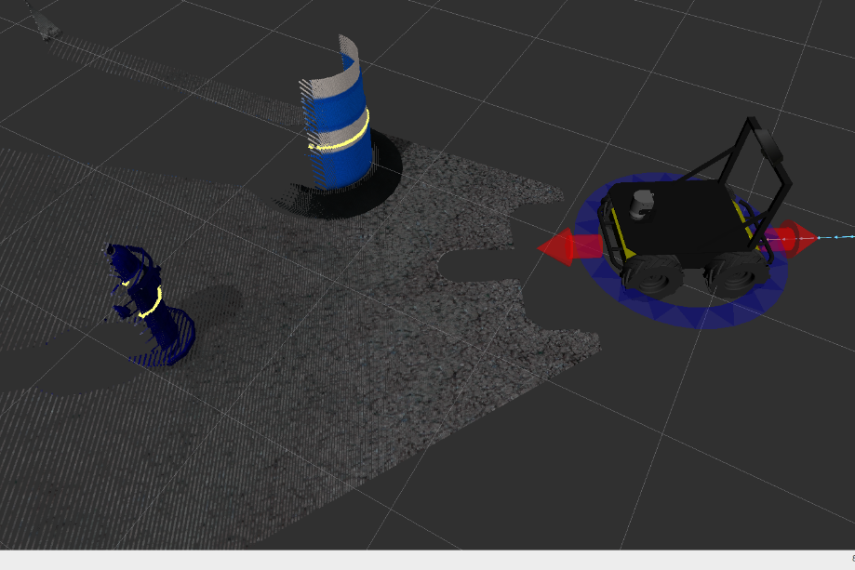

ROS and MATLAB:
Closing the gap between simulation and reality

Slide 2

30 MINUTE GAME PLAN
OBJECTIVE:
Show how ROS and MATLAB work together
AGENDA:
1. Background
2. Overview of ROS & MATLAB
3. Data analysis, real vs. virtual
4. Multi-robot systems and data fusion
5. Questions

Slide 3
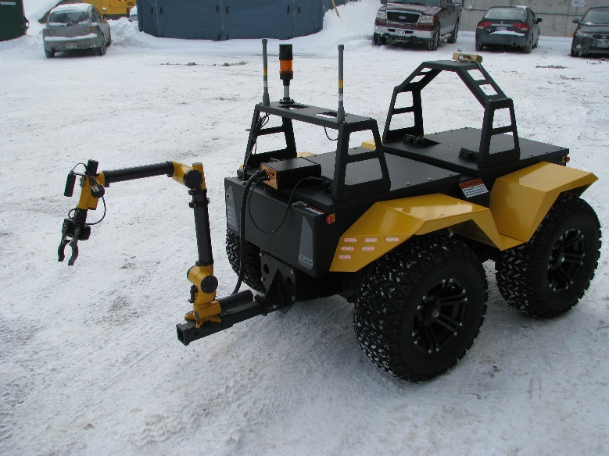
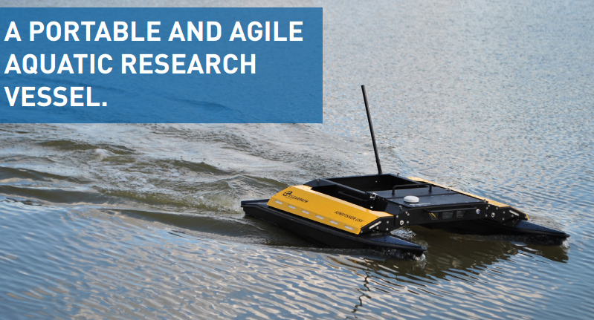
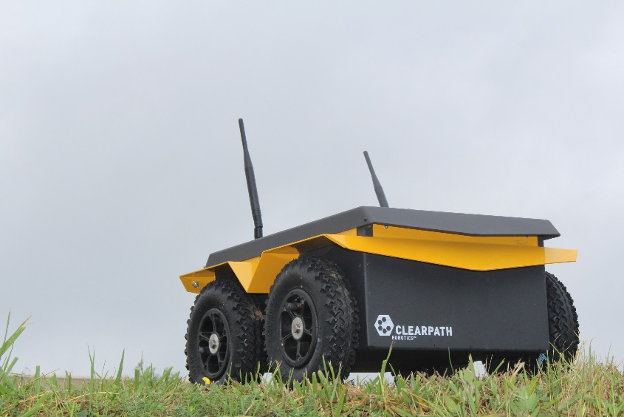
Background
Clearpath Robotics makes robots (surprise!)
Notes:
ROS (Robot Operating System) is BSD-licensed software for controlling robotic components from a PC.
A ROS network is comprised of a number of independent nodes, each of which communicates with the other nodes using a publish/subscribe messaging model.
For example, a particular sensor’s driver might be implemented as a node, which publishes sensor data in a stream of messages.
These messages could be consumed by any number of other nodes, including filters, loggers, and also higher-level systems such as guidance, pathfinding, etc.

Slide 4
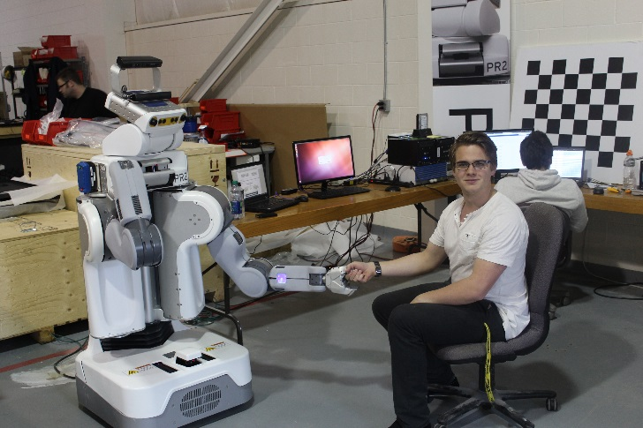
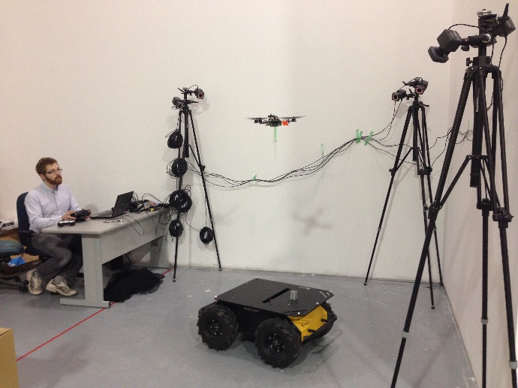
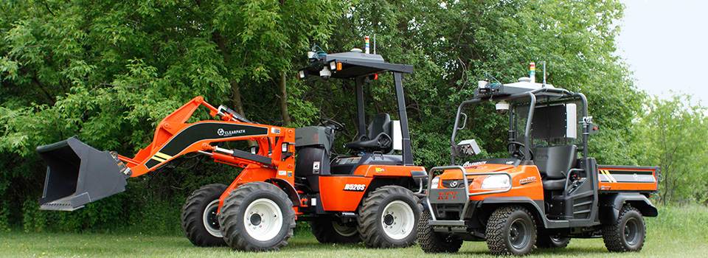
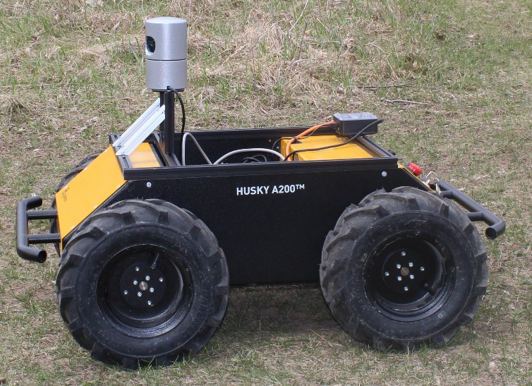
Background
Lots of robots
Notes:
ROS (Robot Operating System) is BSD-licensed software for controlling robotic components from a PC.
A ROS network is comprised of a number of independent nodes, each of which communicates with the other nodes using a publish/subscribe messaging model.
For example, a particular sensor’s driver might be implemented as a node, which publishes sensor data in a stream of messages.
These messages could be consumed by any number of other nodes, including filters, loggers, and also higher-level systems such as guidance, pathfinding, etc.

Slide 5
Overview of ROS & MATLAB
What is ROS?
Lead by the OSRF
BSD
Based on discreet software Nodes
Parallel by nature
Uses message publishing & subscribing
Notes:
ROS (Robot Operating System) is BSD-licensed software for controlling robotic components from a PC.
A ROS network is comprised of a number of independent nodes, each of which communicates with the other nodes using a publish/subscribe messaging model.
For example, a particular sensor’s driver might be implemented as a node, which publishes sensor data in a stream of messages.
These messages could be consumed by any number of other nodes, including filters, loggers, and also higher-level systems such as guidance, pathfinding, etc.

Slide 6
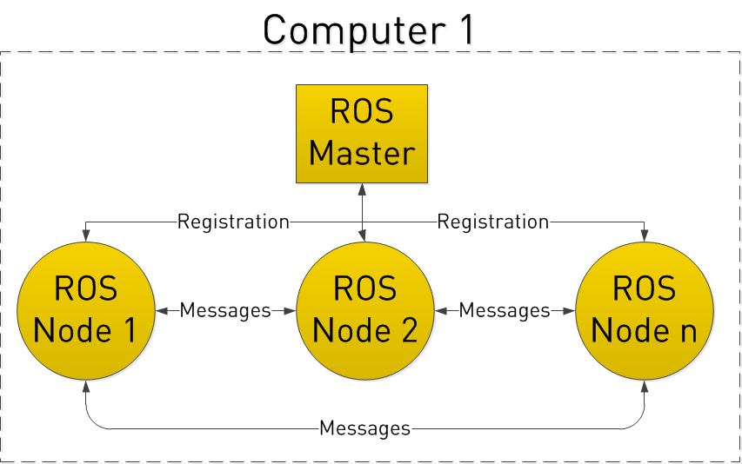
Overview of ROS & MATLAB
Notes:
Let’s look at the ROS system from a very high level view. No need to worry how any of the following works, we will cover that later.
ROS starts with the ROS Master. The Master allows all other ROS pieces of software (Nodes) to find and talk to each other. That way, we do not have to ever specifically state “Send this sensor data to that computer at 127.0.0.1. We can simply tell Node 1 to send messages to Node 2.

Slide 7
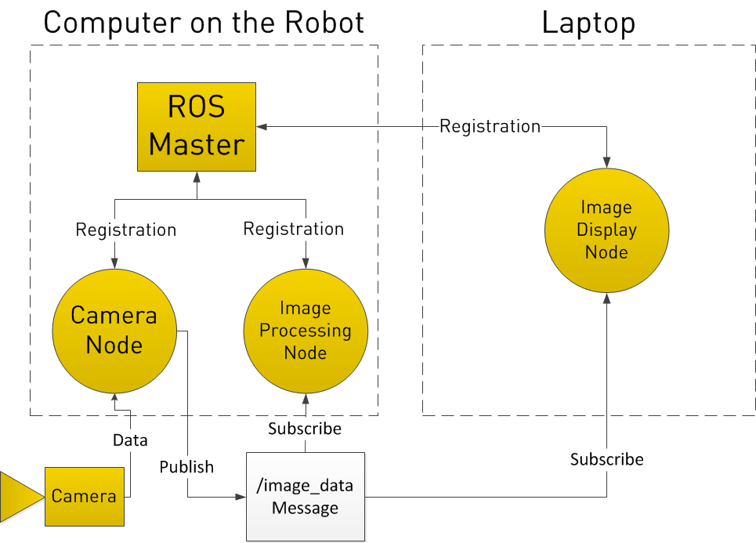
Overview of ROS & MATLAB
Notes:
In registering with the ROS Master, the Camera Node states that it will Publish a Topic called /image_data (for example). Both of the other Nodes register that they are Subscribed to the Topic /image_data.
Thus, once the Camera Node receives some data from the Camera, it sends the /image_data message directly to the other two nodes. (Through what is essentially TCP/IP)

Slide 8
Overview of ROS & MATLAB
Why ROS?
Super flexible
Open source
Lots of talented people contribute to it
Works on everything from a server to an Arduino
Notes:
Note that nodes in ROS do not have to be on the same system (multiple computers) or even of the same architecture! You could have a Arduino publishing messages, a laptop subscribing to them, and an Android phone driving motors. This makes ROS really flexible and adaptable to the needs of the user. ROS is also open source, maintained by many people.

Slide 9
Overview of ROS & MATLAB
What is the MATLAB Robotics System Toolbox?
Ability to publish and subscribe to topics
Call services
Analyze bag files
Convert SimLink code into ROS code
Notes:
Note: NOT the Robotics Toolbox by peter corke

Slide 10
Overview of ROS & MATLAB
Why MATLAB?
Data analysis
Large file processing
Graphing and interpretation
Rapid prototyping and testing

Slide 11
Data analysis, real vs. virtual
Jackal in Simulation
Simple, clean lines are created
No reflections or errors
Wheel slippage is minimal
Battery life is infinite

Slide 12

Data analysis, real vs. virtual
Jackal in Reality
Discontinuous, flickering returns
Unknown reflection amounts and errors
Slippage and pausing on movement
Battery life is 2-3 hours

Slide 13
Multi-robot systems and data fusion

Slide 14
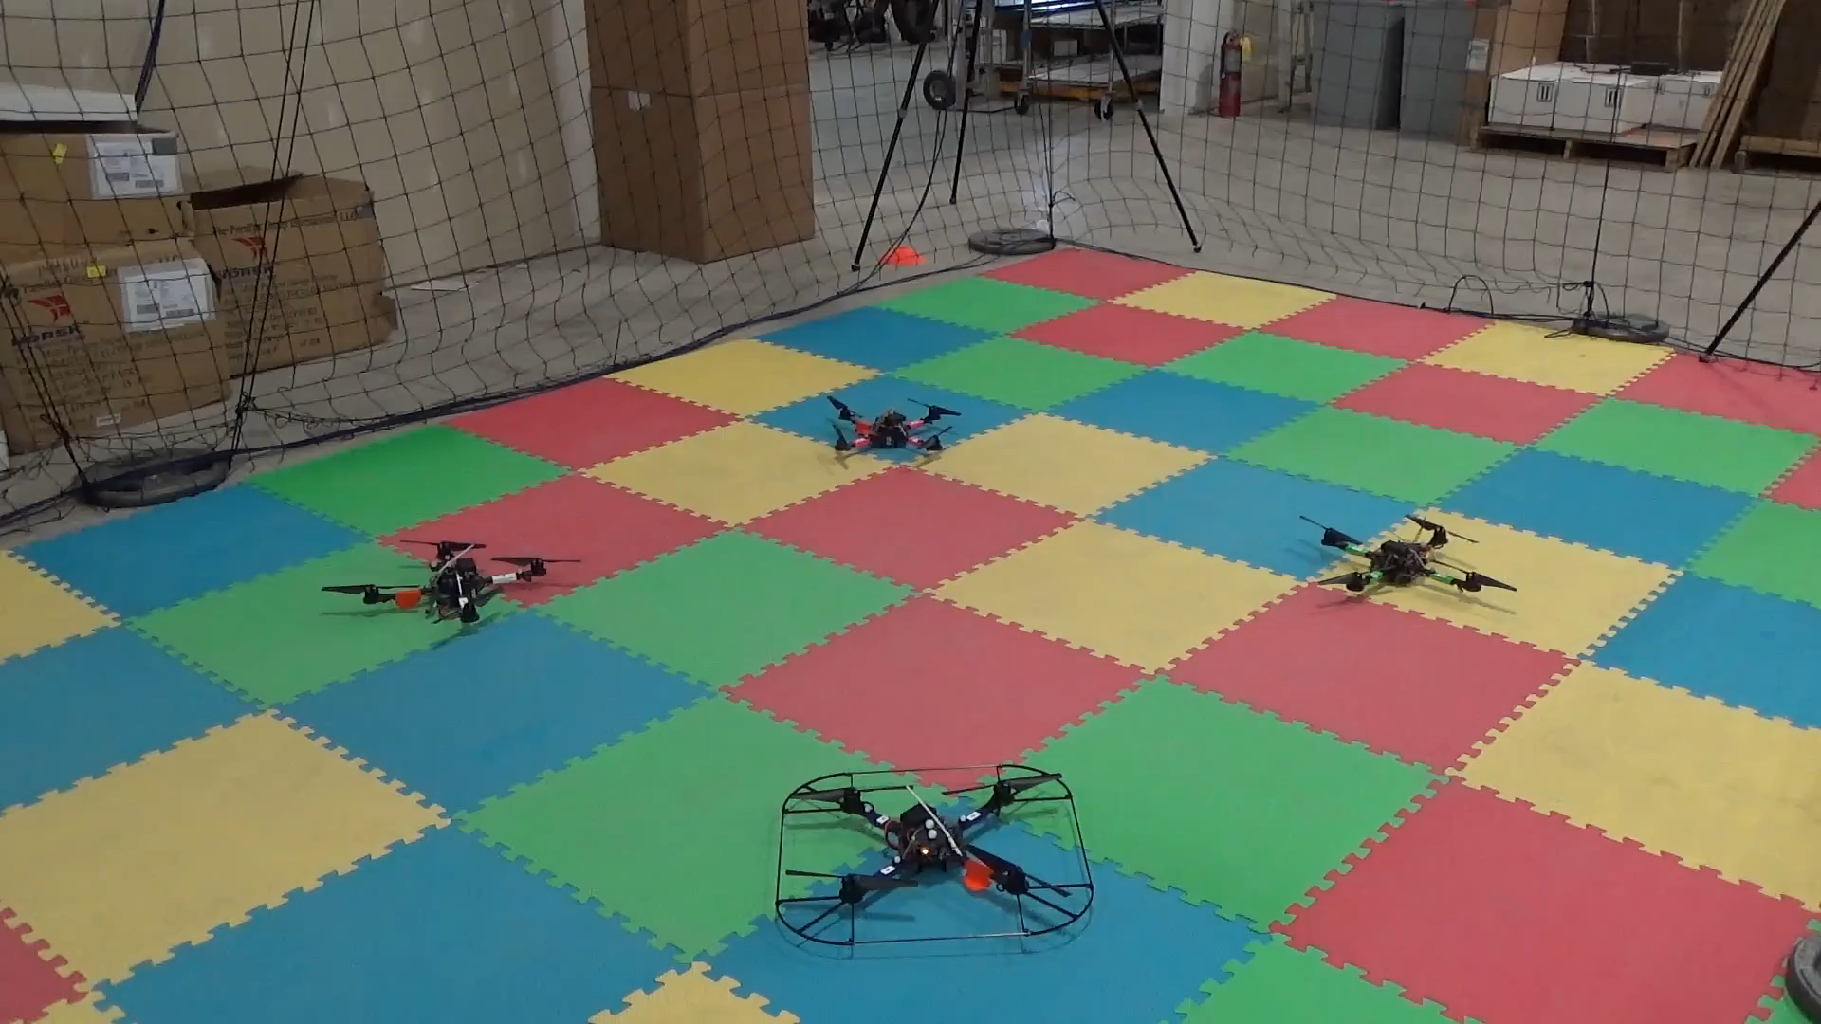
Multi-robot systems and data fusion

Slide 15
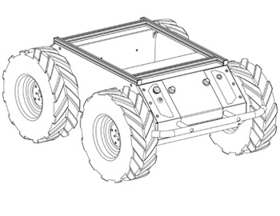
RECAP
ROS and MATLAB compliment each other
ROS is open source, free, and enables easy integration between platforms.
Robotics System Toolbox allows for using ROS from within MATLAB
Practical examples of live and recorded data analysis
Notes:
Ilia sums up lessons learned

Slide 16
RECAP
Find more info!
Look up the Clearpath Robotics ROS 101 tutorial series
Code from this tutorial is here: https://github.com/ibaranov-cp/ICRA_MATLAB
Blog post here: http://www.clearpathrobotics.com/blog/matlab-robotics-system-toolbox-and-ros/
Notes:
Ilia sums up lessons learned

Slide 17
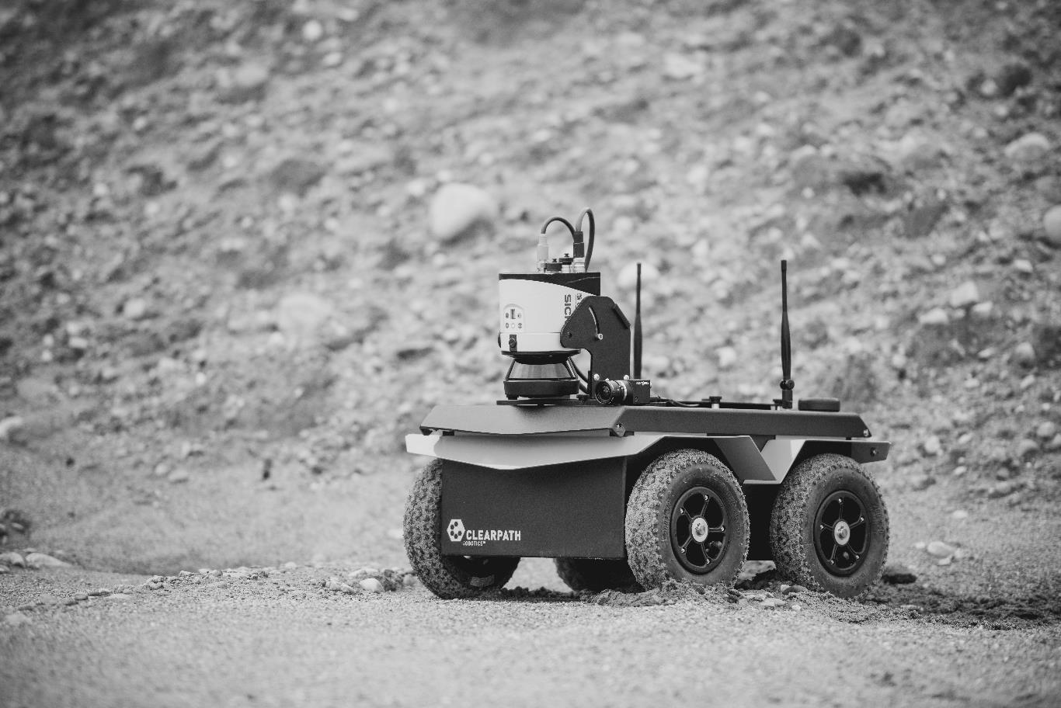
QUESTION AND ANSWER
Knowledge Base: http://support.clearpathrobotics.com
Email: info@clearpathrobotics.com
Website: www.clearpathrobotics.com
CONTACT

Slide 18

BIO
ILIA BARANOV
Senior Engineer
Active within the Open Source Robotics Community, Ilia helps to maintain JACO, Jackal, and PR2 ROS packages; he is also the creator of the ROS 101 blog series.
Ilia holds a degree in electrical engineering from the University of Waterloo and holds two patents related to mobile communication. Robotics and automation has been his lifelong interest!
ibaranov@clearpathrobotics.com
Notes:
Bio if needed

